Slide 1

Personalized Wellness Interventions Through Machine Learning
by cheki wangchuk

Slide 2




Introduction to Data-Driven Healthcare
Rising Concerns
Patient Segmentation
Healthcare increasingly uses data to improve patient outcomes, addressing lifestyle diseases like obesity and diabetes.
Clustering and dimensionality reduction segment populations based on health behaviors for personalized wellness.
Targeted Interventions
Identifying distinct patient profiles informs customized fitness plans, dietary recommendations, and stress management.

Slide 3
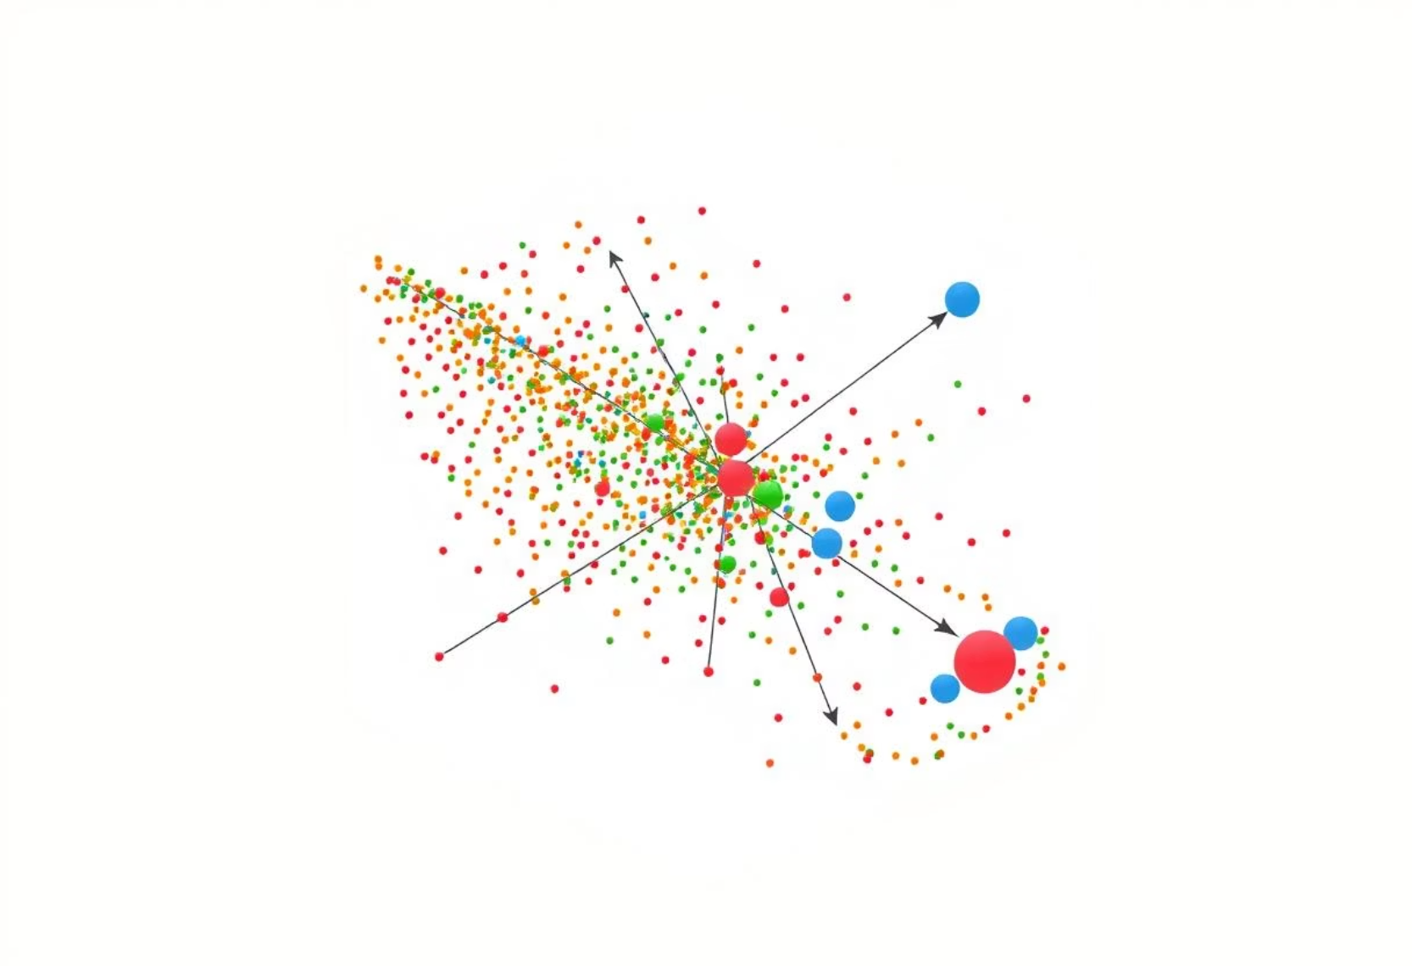
Literature Review
Clustering techniques like K-means and Hierarchical Clustering are valuable in healthcare analytics for identifying patient subgroups. Studies by Si et al. (2021) and Tian and Tien (2020) show their effectiveness in segmenting patients and identifying behavioral patterns.
Principal Component Analysis (PCA) reduces data complexity, improving clustering performance by reducing noise. Lever et al. (2017) highlight PCA's ability to preserve essential data variance.
Despite advances, challenges remain in data quality and translating results into clinical practice. Recent work by Rajkomar et al. (2021) shows successful integration of machine learning into clinical workflows.

Slide 4

Methodology: Research Design and Data
Research Design
Quantitative, exploratory analytics using unsupervised machine learning to identify patient segments based on lifestyle factors.
Data Source
Simulated_health_wellness_data.csv dataset with 200 anonymized patient records, including exercise, meals, sleep, stress, and BMI.
Data Analysis
Four-phase approach: preprocessing (Z-score normalization), EDA, clustering (K-Means, Hierarchical), and dimensionality reduction (PCA).
Model Evaluation
Assessed cluster quality using silhouette scores, within-cluster sum of squares, and Dunn indices, visualized with scatter plots and parallel coordinate plots.

Slide 5
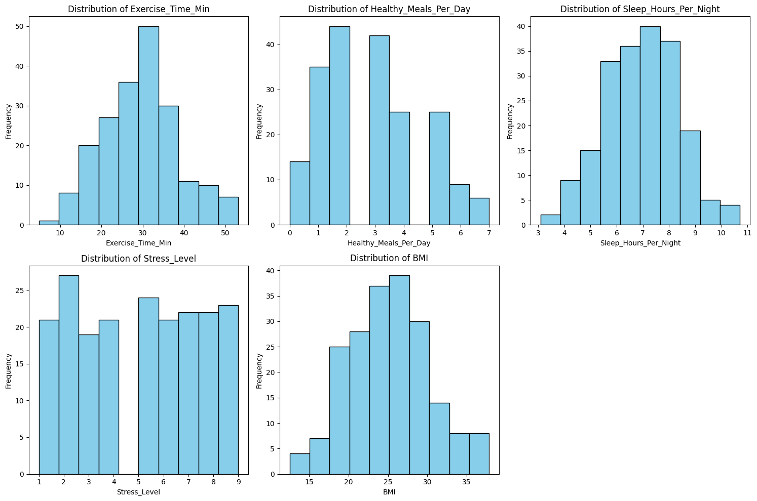
Findings
Exploratory Data Analysis
Statistic | Exercise_Time_Min | Healthy_Meals_Per_Day | Sleep_Hours_Per_Night | Stress_Level | BMI
count | 200.000000 | 200.000000 | 200.000000 | 200.000000 | 200.000000
mean | 29.569384 | 2.850000 | 6.940130 | 4.995000 | 25.149719
std | 9.218449 | 1.747216 | 1.401483 | 2.605556 | 5.070047
min | 4.859021 | 0.000000 | 3.088343 | 1.000000 | 12.502971
25% (Q1) | 22.948723 | 2.000000 | 5.967243 | 3.000000 | 21.458196
50% (median) | 29.958081 | 3.000000 | 6.972331 | 5.000000 | 25.155662
75% (Q3) | 35.008525 | 4.000000 | 7.886509 | 7.000000 | 28.011155
max | 53.098227 | 7.000000 | 10.708419 | 9.000000 | 37.840594

Slide 6
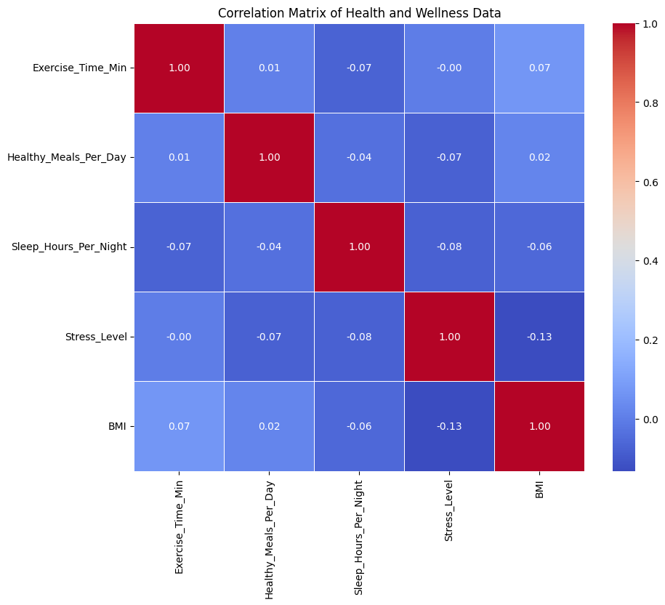
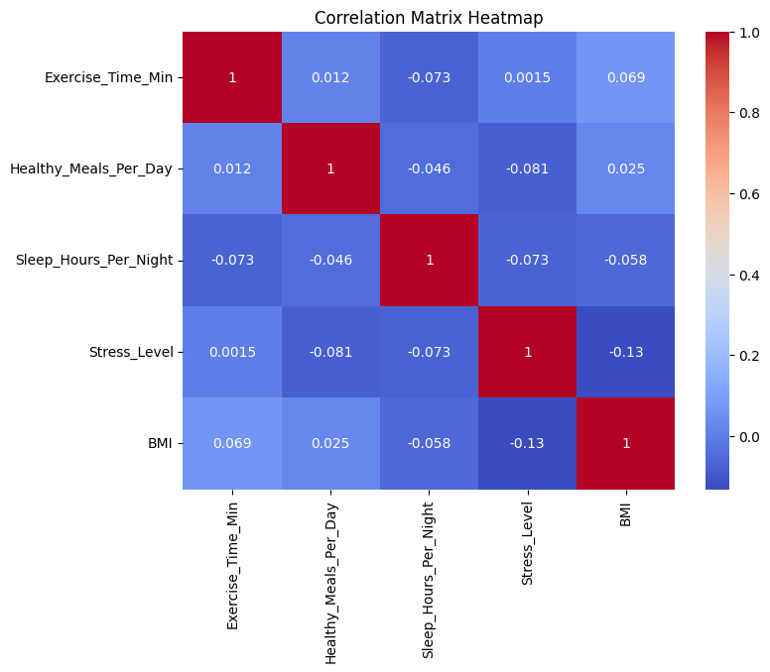
Correlation Matrix Before Normalization
Correlation Matrix After Normalization

Slide 7
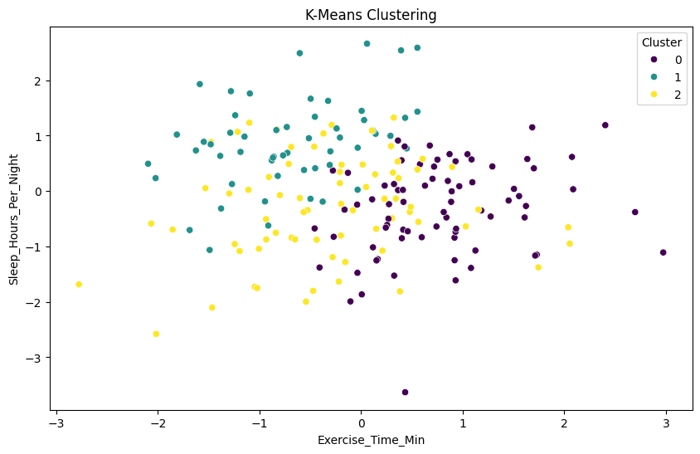
Model Evaluation
K-Means Clustering Model
K-Means Clustering Model Evaluation
Metric | Value
Inertia | 725.451546
Silhouette Score | 0.155064

Slide 8
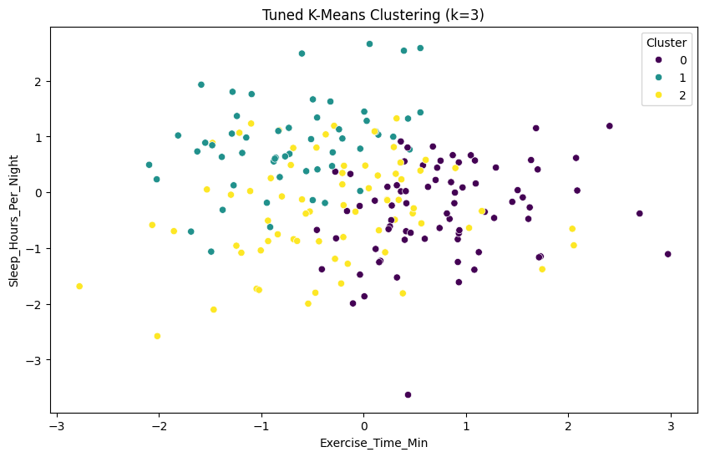
Tuned K-Means Clustering Model
Tuned K-Means Clustering Model Evaluation
Metric | Value
Inertia | 431.937903
Silhouette Score | 0.17957

Slide 9
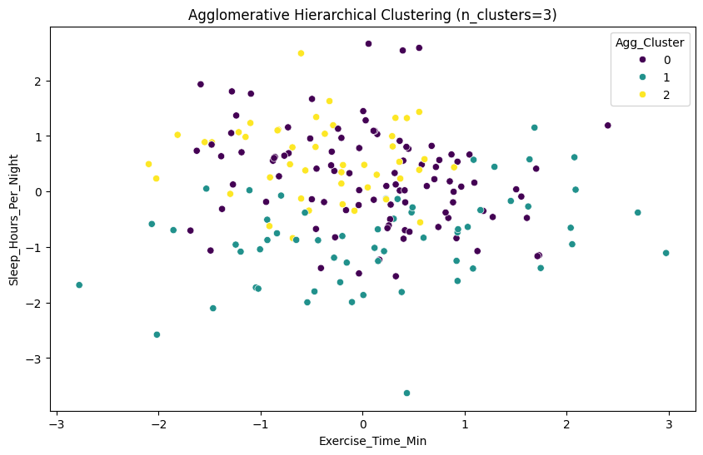
Agglomerative Hierarchical Clustering
Agglomerative Hierarchical Clustering Evaluation
Metric | Value
Inertia | 189.774351
Silhouette Score | 0.136285

Slide 10
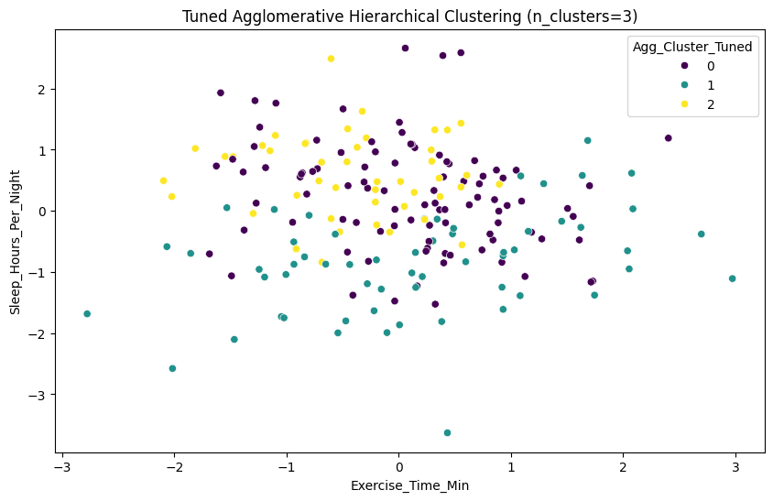
Tuned Agglomerative Hierarchical Clustering
Tuned Agglomerative Hierarchical Clustering Evaluation
Metric | Value
Silhouette Score | 0.136285
Inertia | 189.774351

Slide 11
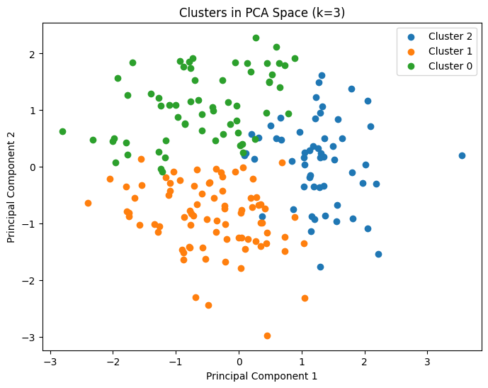
Principal Component Analysis (PCA)
PCA Evaluation Matrix
Metric | Value
Silhouette Score | 0.158478
Davies-Bouldin Index | 1.810476
Calinski-Harabasz Index | 38.487195

Slide 12
Tuned Principal Component Analysis (PCA)
Tuned PCA Evaluation Matrix
Metric | Value
Silhouette Score | 0.1878
Davies-Bouldin | 1.4191
Calinski-Harabasz | 36.4878

Slide 13
Comparative Performance Metrics of Clustering Models Before and After Tuning
Model Type | Metric | Before Tuning | After Tuning | % Improvement
K-Means | Inertia | 725.452 | 431.938 | 40.5%
 | Silhouette Score | 0.155 | 0.180 | 16.1%
Hierarchical | Inertia | 215.301 | 189.774 | 11.9%
 | Silhouette Score | 0.121 | 0.136 | 12.4%
 | Cophenetic Corr. | 0.82 | 0.88 | 7.3%
PCA-Based | Silhouette Score | 0.158 | 0.188 | 18.9%
 | Davies-Bouldin Index | 1.810 | 1.419 | 21.6%
 | Calinski-Harabasz | 38.487 | 36.488 | -5.2%

Slide 14

Discussion
High-risk cluster consistently identified across models.
Tuning improved clarity and clinical relevance.
Age-stratified patterns supported life-stage-specific wellness.
PCA offered better separation with trade-off in density.

Slide 15

Conclusion
3 distinct patient groups found across all methods (K-Means, hierarchical, PCA).
High-risk group: Low activity + poor sleep (needs urgent intervention).
Tuning boosted results:
K-Means: 40% better clustering
PCA: 19% clearer group separation
Actionable insights: Enables personalized prevention strategies.
Next steps: Test in real-world data, add diet/mental health factors.

Slide 16
Reference
Alley, S., Van Uffelen, J. G., Schoeppe, S., Parkinson, L., Hunt, S., Power, D., Duncan, M. J., Schneiders, A., & Vandelanotte, C. (2019). Efficacy of a computer-tailored web-based physical activity intervention using Fitbits for older adults: a randomised controlled trial protocol. BMJ Open, 9(12), e033305. https://doi.org/10.1136/bmjopen-2019-033305
Aranganayagi, S., & Thangavel, K. (2009). Clustering Categorical Data Using Silhouette Coefficient as a Relocating Measure. In In International Conference on Computational Intelligence and Multimedia Applications (pp. 13–17). https://doi.org/10.1109/iccima.2007.328
Bates, D. W., Saria, S., Ohno-Machado, L., Shah, A., & Escobar, G. (2014). Big data in health care: Using analytics to identify and manage High-Risk and High-Cost patients. Health Affairs, 33(7), 1123–1131. https://doi.org/10.1377/hlthaff.2014.0041
Bouveyron, C., & Brunet-Saumard, C. (2014). Model-based clustering of high-dimensional data: A review. Computational Statistics & Data Analysis, 71, 52–78. https://doi.org/10.1016/j.csda.2012.12.008
Goldstein, S. P., Evans, B. C., Flack, D., Juarascio, A., Manasse, S., Zhang, F., & Forman, E. M. (2021). Return of the restrict-binge cycle: A network analysis of the post-treatment period following a behavioral weight loss intervention. Obesity, 29(1), 77-83.
Kom, I. a. R. Y., Dongelmans, D. A., De Keizer, N. F., Jager, K. J., Schut, M. C., Abu-Hanna, A., & Klopotowska, J. E. (2022). Electronic health record-based prediction models for in-hospital adverse drug event diagnosis or prognosis: a systematic review. Journal of the American Medical Informatics Association, 30(5), 978–988. https://doi.org/10.1093/jamia/ocad014
Lever, J., Krzywinski, M., & Altman, N. (2017). Principal component analysis. Nature Methods, 14(7), 641–642. https://doi.org/10.1038/nmeth.4346

Slide 17
Rajkomar, A., Oren, E., Chen, K., Dai, A. M., Hajaj, N., Hardt, M., Liu, P. J., Liu, X., Marcus, J., Sun, M., Sundberg, P., Yee, H., Zhang, K., Zhang, Y., Flores, G., Duggan, G. E., Irvine, J., Le, Q., Litsch, K., . . . Dean, J. (2018). Scalable and accurate deep learning with electronic health records. Npj Digital Medicine, 1(1). https://doi.org/10.1038/s41746-018-0029-1
Si, Y., Wang, J., Xu, H., & Roberts, K. (2019). Enhancing clinical concept extraction with contextual embeddings. Journal of the American Medical Informatics Association, 26(11), 1297–1304. https://doi.org/10.1093/jamia/ocz096
Tian, W., & Tien, J. J. (2020). Health Behaviors and Health Status among Middle-Aged and Older Adults with Chronic Diseases in Taiwan. International Journal of Environmental Research and Public Health, 17(19), 7196. https://doi.org/10.3390/ijerph17197196
Topol, E. J. (2018). High-performance medicine: the convergence of human and artificial intelligence. Nature Medicine, 25(1), 44–56. https://doi.org/10.1038/s41591-018-0300-7
Weiskopf, N. G., Hripcsak, G., Swaminathan, S., & Weng, C. (2013). Defining and measuring completeness of electronic health records for secondary use. Journal of Biomedical Informatics, 46(5), 830–836. https://doi.org/10.1016/j.jbi.2013.06.010

Slide 18


